Slide 1

S&P500 Index
Dean gani

Slide 2

What is s&p500 index
The Standard and Poor's 500, or simply the S&P 500, is a stock market index tracking the stock performance of 500 of the largest companies listed on stock exchanges in the United States. It is one of the most commonly followed equity indices and includes approximately 80% of the total market capitalization of U.S. public companies, with an aggregate market cap of more than $43 trillion as of January 2024.

Slide 3
Data description
Number of Observations: 6037 days
Time Period: 2000 to 2024
Volume Data:
Average Volume: 3.33 billion shares
Standard Deviation: 1.51 billion shares
Minimum Volume: 356 million shares
Maximum Volume: 11.46 billion shares
Median (50th Percentile) Volume: 3.44 billion shares
Price Data (in USD):
Average Closing Price: $1973.59
Standard Deviation: $1061.34 (indicating significant volatility)
Minimum Closing Price: $676.53
Maximum Closing Price: $4796.56
Median (50th Percentile) Closing Price: $1457.34
The S&P 500 experienced significant growth and volatility over the period, with prices ranging from $676.53 to $4796.56.
Trading volumes varied widely, reflecting different market conditions and events, with an average volume of 3.33 billion shares per day.
The dataset is complete with no missing values, providing a robust basis for analysis.

Slide 4
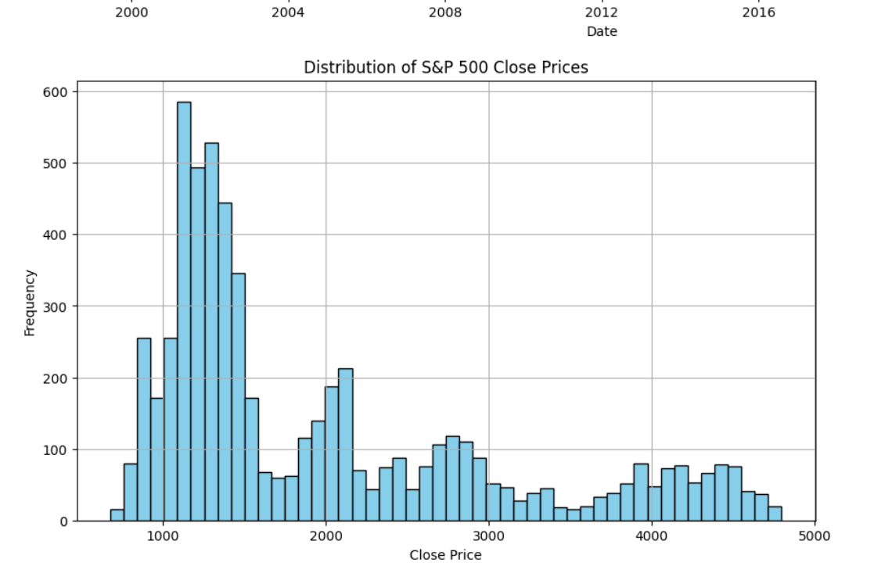
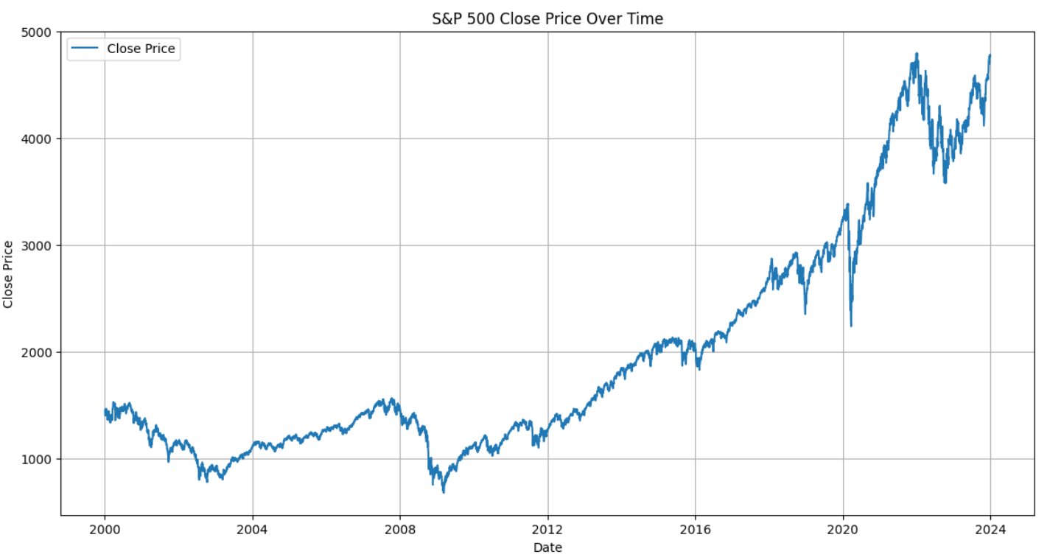
Data charts

Slide 5
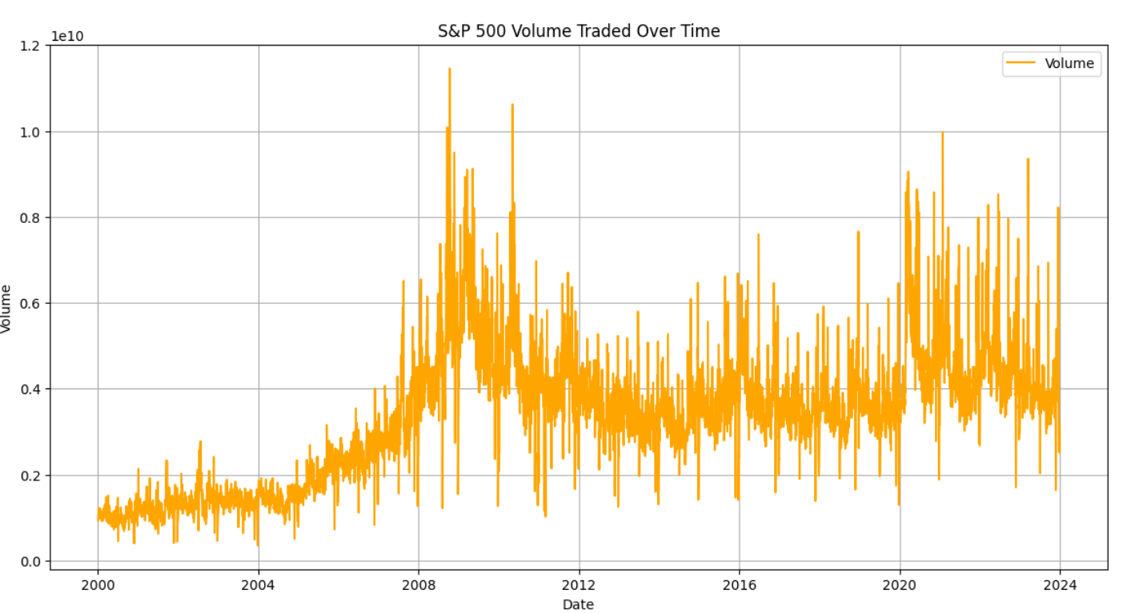
Trading volume
From 2000 to 2007, there is a gradual increase in trading volume, indicating a growing interest and activity in the S&P 500
In 2008, there is a significant spike in trading volume, which corresponds to the global financial crisis. This period was marked by high volatility and increased trading activity.
After 2008, the volume remains elevated but shows fluctuations. The period around 2010-2011 shows notable peaks which could correspond to various economic events or market uncertainties.
rom 2012 to 2016, the volume appears to stabilize somewhat but continues to show significant peaks and troughs.
Around 2020, there is another noticeable increase in trading volume, likely related to the COVID-19 pandemic and the associated market turmoil.
Post-2020, the trading volume remains high but shows volatility, reflecting ongoing market activity and events.

Slide 6
Simple moving average
A Simple Moving Average (SMA) is a commonly used technical indicator in stock trading that helps to smooth out price data by creating a constantly updated average price. The SMA is calculated by adding the closing prices of a security over a specific number of periods and then dividing by that number of periods. For example:
50-Day SMA: This is the average closing price over the last 50 days.
200-Day SMA: This is the average closing price over the last 200 days

Slide 7
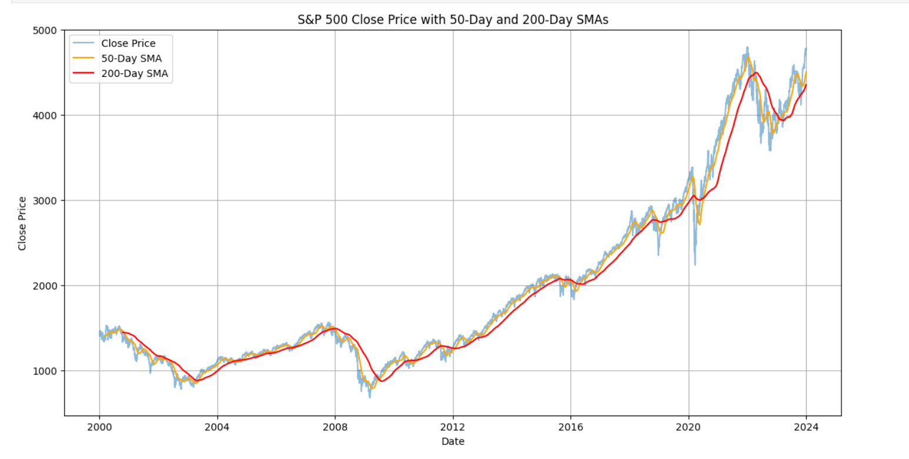
The graph shows an overall upward trend in the S&P 500 closing prices over the period, indicating a long-term bullish market.
Periods of significant declines are visible, notably around 2008 (financial crisis) and early 2020 (COVID-19 pandemic).
50-Day SMA (Orange Line): This line closely follows the short-term price movements. When the close price crosses above the 50-day SMA, it often indicates a potential short-term uptrend. Conversely, when it crosses below, it may indicate a short-term downtrend.
200-Day SMA (Red Line): This line is smoother and less reactive to short-term price changes, showing longer-term trends. The S&P 500's price generally staying above the 200-day SMA is a bullish sign, while consistently falling below it may indicate a bearish trend.
Crossover Points:When the 50-day SMA crosses above the 200-day SMA (a "Golden Cross"), it is often seen as a bullish signal.
When the 50-day SMA crosses below the 200-day SMA (a "Death Cross"), it is often seen as a bearish signal.

Slide 8
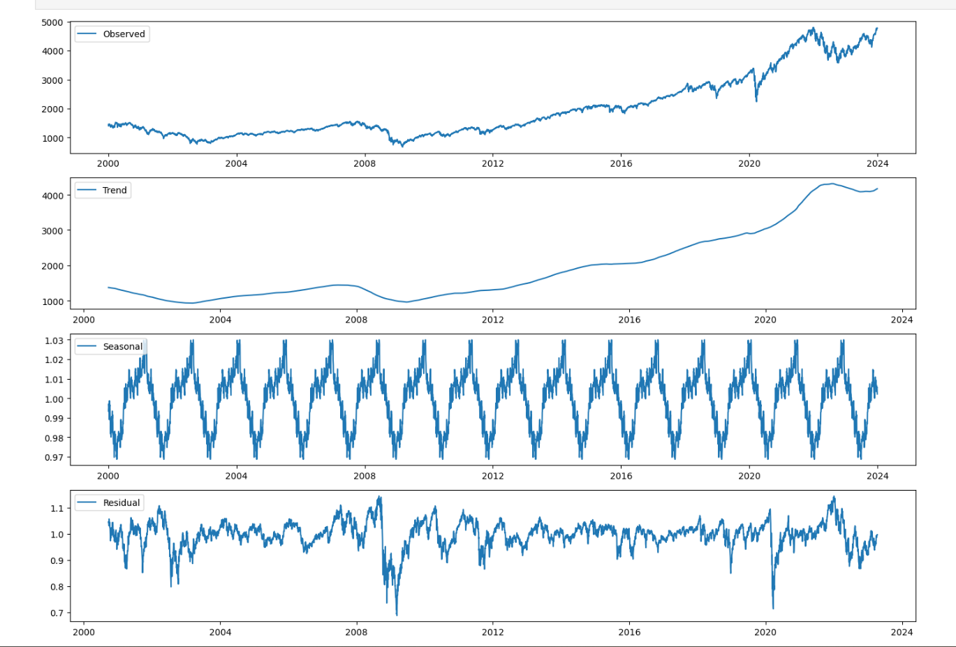
Trend,seasonal,residual
Observed: The original data shows the overall increase in the S&P 500 index over the years, with notable dips during major economic downturns such as the 2008 financial crisis and the 2020 COVID-19 pandemic.
Trend: The trend component confirms a long-term growth pattern, especially post-2012, which aligns with the recovery from the financial crisis and subsequent economic growth. The flattening around 2020-2024 might be due to market uncertainties and adjustments during and after the pandemic.
Seasonal: The seasonal component reveals regular cyclical patterns, indicating that certain times of the year consistently exhibit higher or lower market activity. This is typical in financial markets due to factors like quarterly earnings reports, fiscal year-end activities, and other recurring events.
Residual: The residual component shows the noise in the data, with significant fluctuations during major market events. Large spikes in the residuals around 2008 and 2020 highlight the impact of the financial crisis and the pandemic.

Slide 9
Testing
1. Difference in Mean Close Price Before and After 2008
Hypothesis: The mean closing prices before and after January 1, 2008, are different.
Mean Close Before 2008: ≈1213.12
Mean Close After 2008: ≈2353.16
T-Statistic: −63.248
P-Value: 0.0
There is a significant increase in the mean closing price after 2008. The t-statistic is extremely large in magnitude, and the p-value is effectively zero, indicating a highly significant difference.

Slide 10
testing
2. Variance of Close Price
Hypothesis: Testing if the variance of the close price follows a chi-squared distribution.
Variance Close Price: ≈1126433.84
Chi-Square Statistic: 3445075.49
P-Value: 0.0
The variance is high, and the chi-square test shows a significant result (p-value of 0.0), indicating the variance is significantly different from what would be expected under the null hypothesis.
3. Volatility Before and After 2008
Hypothesis: The volatility (standard deviation) of the closing prices is different before and after January 1, 2008.
Standard Deviation Before 2008: ≈186.57
Standard Deviation After 2008: ≈1112.93
F-Statistic: 2079.79
P-Value: 0.0
The standard deviation of the closing prices after 2008 is much higher than before, indicating increased volatility. The F-statistic is very large, and the p-value is effectively zero, confirming a significant difference in volatility.

Slide 11
Normality test
1. Shapiro-Wilk Test
Hypothesis: Tests if the data follows a normal distribution.
Statistic: 0.8374
P-Value: 0.0
Interpretation: The Shapiro-Wilk test statistic is 0.8374, and the p-value is extremely low. Since the p-value is much lower than 0.05, we reject the null hypothesis, indicating that the S&P 500 closing prices do not follow a normal distribution.
2. Kolmogorov-Smirnov (K-S) Test
Hypothesis: Tests if the data follows a specified distribution, in this case, a normal distribution.
Statistic: 0.205
P-Value: 0.0
Interpretation: The K-S test statistic is 0.2050, and the p-value is again extremely low. This result suggests that the S&P 500 closing prices significantly deviate from a normal distribution.

Slide 12
Stationary test
1. Augmented Dickey-Fuller (ADF) Test
Hypothesis:
Null Hypothesis (H0): The time series has a unit root (i.e., it is non-stationary).
Alternative Hypothesis (H1): The time series is stationary.
Results:
ADF Statistic: 1.5435
P-Value: 0.9977
Critical Values:
1%: -3.4314
5%: -2.8620
10%: -2.5670
Interpretation: The ADF test statistic is 1.5435, which is higher than all the critical values at 1%, 5%, and 10% levels. The p-value is 0.9977, which is much higher than 0.05. Since the p-value is significantly greater than 0.05, we fail to reject the null hypothesis, indicating that the S&P 500 closing prices are non-stationary according to the ADF test.

Slide 13
After diff stationary test
Augmented Dickey-Fuller (ADF) Test on Differenced Series
Hypothesis:
Null Hypothesis (H0): The differenced series has a unit root (i.e., it is non-stationary).
Alternative Hypothesis (H1): The differenced series is stationary.
Results:
ADF Statistic: -15.4304
P-Value: 0,0
Critical Values:
1%: -3.4314
5%: -2.8620
10%: -2.5670
Interpretation: The ADF test statistic is -15.4304, which is lower than the critical values at 1%, 5%, and 10% levels. The p-value is low (0.0), which is much less than 0.05. Therefore, we reject the null hypothesis, indicating that the differenced series is stationary.

Slide 14
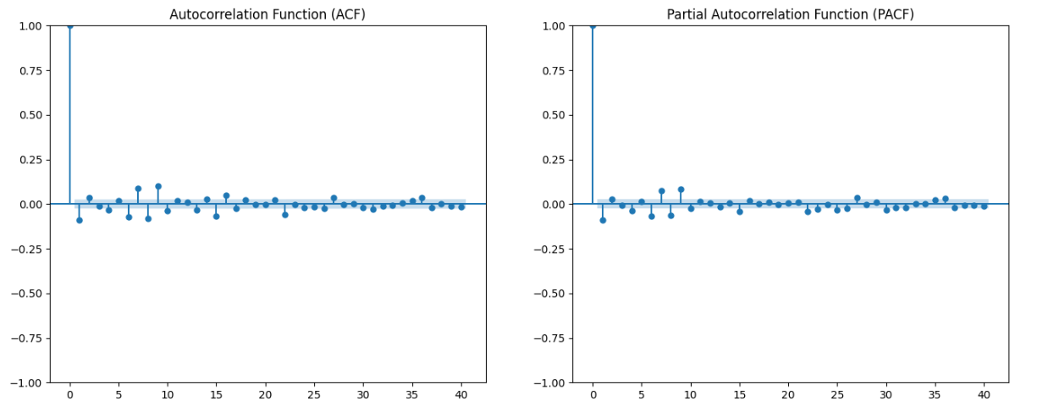
Machine learning

Slide 15
Why we need acf and pacf
Why We Need ACF and PACF
Model Identification:
ARIMA Modeling: These plots are crucial for identifying the order of AR (AutoRegressive) and MA (Moving Average) terms in ARIMA models.
AR Terms: Identified using the PACF plot. If the PACF plot shows significant partial correlations up to lag ppp and then cuts off, an AR model of order ppp might be appropriate.
MA Terms: Identified using the ACF plot. If the ACF plot shows significant correlations up to lag qqq and then cuts off, an MA model of order qqq might be appropriate.
Differencing: If the ACF and PACF plots show a slow decay, it suggests that the series may need differencing to achieve stationarity.

Slide 16
Arima orders
What is ARIMA Modeling?
ARIMA (AutoRegressive Integrated Moving Average) is a popular and widely used statistical method for time series forecasting. It is particularly effective for analyzing and predicting data that shows trends, seasonality, or other patterns over time.
ARIMA(1, 1, 1):p = 1: Because the PACF plot suggests that only the first lag has significant partial autocorrelation.
d = 1: The series has been differenced once to achieve stationarity.
q = 1: Because the ACF plot suggests that only the first lag has significant autocorrelation.

Slide 17
Forcasting
To be continued…

